Slide 1


GLOBAL TRENDS IN PREMATURE NCD DEATHS & IMPLICATIONS FOR RWANDA
Capstone Project – INSY 8413: Introduction to Big Data Analytics (2024–2025)
Presented by: MUHIRE Samuel
Date: 1/August /2025

Slide 2
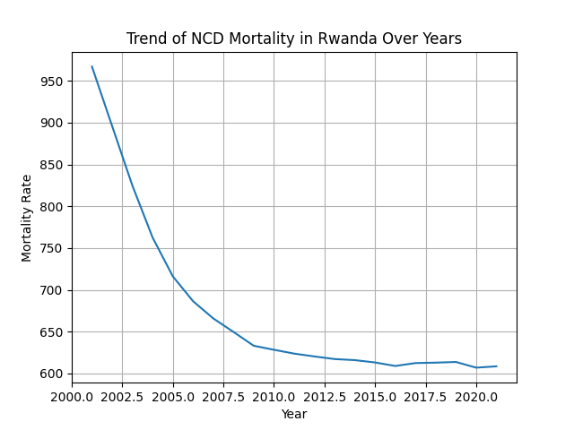
Sector & Problem Definition
Sector Chosen: ✅ Health
Problem Statement:
Can global health data help predict trends in premature deaths caused by noncommunicable diseases (NCDs) such as diabetes, cardiovascular disease, cancer, and chronic respiratory conditions?

Slide 3
Premature NCD Mortality Global Dataset
Source Link: https://www.who.int/data/gho/data/indicators/indicator-details/GHO/ncd-deaths-premature-due-to-ncd-as-proportion
Rows/Columns: e.g., 10,000 rows × 15 columns
Structure: ✅ Structured (CSV)
Status: ❌ Requires preprocessing (missing values, duplicates, etc.)

Slide 4
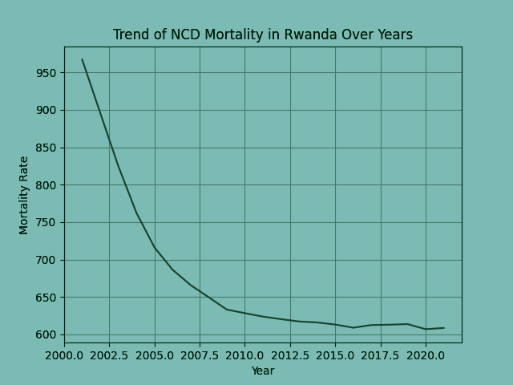
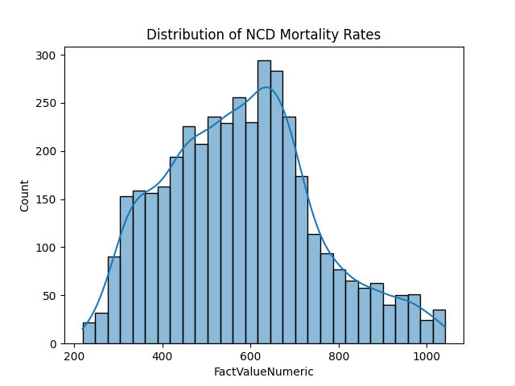
Python Analysis – Cleaning
Handled Tasks:
Missing value imputation (mean/mode)
Column renaming for clarity
Encoding categorical columns
Removing duplicates & outliers
(Show a screenshot of cleaned dataset head)

Slide 5
Exploratory Data Analysis (EDA)
HIGHEST PREMATURE NCD RATES: SUB-SAHARAN AFRICA & SOUTHEAST ASIA
GENDER DISPARITY: MEN MORE AFFECTED GLOBALLY

Slide 6
Machine Learning Model
Model Chosen: Logistic Regression (or Decision Tree, etc.)
Target Variable: Premature Death (Yes/No)
Training/Testing Split: 70% / 30%
Innovation: Added custom feature: NCD_risk_index

Slide 7
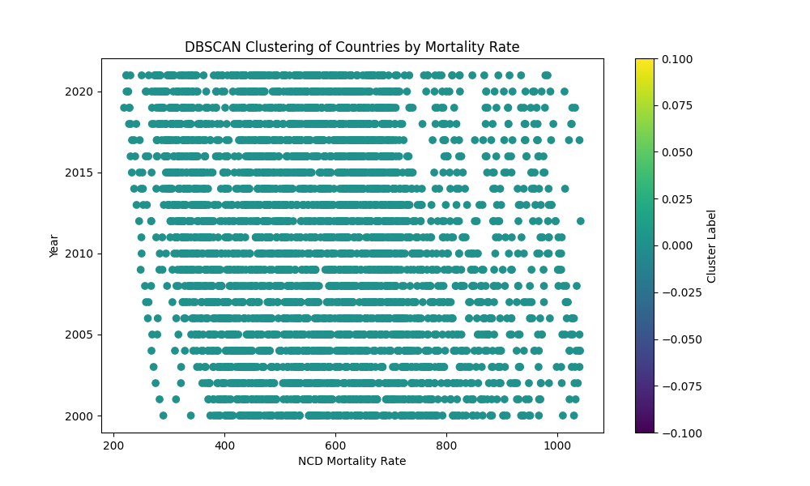
Detecting High-Risk Countries with DBSCAN
DBSCAN used to detect clusters of high NCD mortality
Parameters optimized for density-based separation
Identified high-risk regions globally

Slide 8
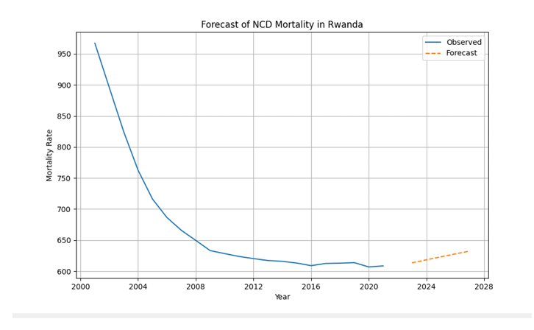
Time Series Forecasting (ARIMA)
Forecasted Rwanda’s NCD rates up to 2030
ARIMA(1,1,1) provided best fit based on AIC
Slight upward trend predicted

Slide 9
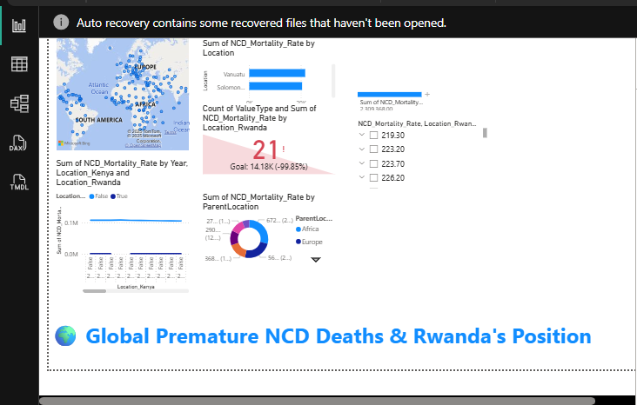
Interactive Visualization with Power BI
MAP, BAR CHART, KPI CARDS, SLICERS FOR GENDER & YEAR
FOCUS: RWANDA’S TRENDS IN CONTEXT OF GLOBAL RATES
USERS CAN EXPLORE CUSTOM insights

Slide 10
Python Side:
Custom risk index (combining lifestyle, income, and region)
Feature importance analysis
Power BI Side:
DAX formulas for dynamic comparisons
Custom bookmarks and AI insights
Innovative
Features

Slide 11
Challenges & Solutions
Challenge 1: Missing data
✅ Used imputation strategies
Challenge 2: Imbalanced classes
✅ Used stratified sampling
Challenge 3: Visualization overload
✅ Used filters & drill-downs for clarity

Slide 12
Recommendations
Governments should monitor male NCD death trends
Invest in early screening programs in high-risk regions
Public health campaigns for lifestyle-related risks

Slide 13

Tools & Techniques
Python (Pandas, ARIMA, DBSCAN, Seaborn, Scikit-learn)
Power BI (Interactive visuals, DAX measures)
Custom function for high-mortality country flagging

Slide 14

Lessons Learned
Time series needs longer historical data for accuracy
Clustering sensitive to scaling and parameter tuning
Visual storytelling critical for engagement
Thank you for your attention!

